Slide 1
BlackSpot Miner
DMBI CA2 Mini Project · D15A Group 09 · SDG 3 and SDG 11
Mining road collision data to locate severe-crash hotspots and prioritise road safety action
513,801
804
107 of 109
0.764
real collisions, 2021 to 2025
street-scale hotspots of fatal and serious crashes
rules held on unseen 2025
next-year site ROC-AUC, past counts 0.680
Jaiprakash Talreja (54) · Adarsh Singh (52) · Vidushi Singh (53) · Piyush Shukla (49)
Notes:
Speaker: Jaiprakash. Good morning. We are Group 9. Our project is BlackSpot Miner. We took five years of real police collision records and asked a practical question: if a road authority has a limited safety budget, where should it spend it? KSI on these slides means killed or seriously injured.

Slide 2
A safety budget cannot fix every road, so where should it go?
1.19 million
Where?
Which street-scale places concentrate severe collisions?
DBSCAN hotspots
road deaths a year worldwide (WHO, 2023)
1.72 lakh
Why?
Which conditions raise the chance of a death or serious injury (KSI)?
Apriori rules, K-Modes segments
road deaths in India in 2023 (MoRTH)
SDG 3.6
What next?
Which sites should be treated first next year?
Classification and site ranking
target on road traffic deaths and injuries
Notes:
Speaker: Jaiprakash. Road crashes kill about 1.19 million people a year, and India recorded about 1.72 lakh deaths in 2023. An authority can only treat a limited number of sites. Ranking last year's worst sites is the common answer, but bad years are partly bad luck. So we split the problem into three questions: where, why and what next. Our reference paper mined road accidents in Dehradun. It used clustering and association rules but no prediction and no test on later data, and that is the gap we build on.

Slide 3
Eight stages take raw records to a decision
1
2
3
4
Problem
Data
Preprocessing
Algorithm
Limited budget, where to act
513,801 collisions
Audit, clean, encode
DBSCAN, Apriori, K-Modes, classifiers
8
7
6
5
Decision
Insights
Evaluation
Results
2026 priority list
Places and combinations
Unseen 2025 test year
Hotspots, rules, site scores
Notes:
Speaker: Jaiprakash. This is the same process from our CA1 case study, now implemented. One prepared data set feeds three branches: hotspots, rules and prediction. All three feed one decision. Everything is tested on 2025, a year never used in mining or training. Over to Adarsh for the data.

Slide 4
A reporting change would have faked a trend, so we audited first
Why it matters
15 of 44 police force codes changed system in five years. Raw KSI share goes from 22.51% to 26.24%. A model trained on it would partly learn a change of form, not a change in road risk.
Notes:
Speaker: Adarsh. Our data is the UK Department for Transport STATS19 record: 513,801 collisions, 937,265 vehicles and 652,821 casualties. Before modelling we checked every field year by year, and that found a trap. Police forces have been moving to injury-based reporting, which classifies more injuries as serious. On the left, that share jumped from 49.6 to 86.5 percent. On the right, the raw severe share rises faster than the adjusted one. So raw severity is not comparable across years. We used DfT's adjusted figures for location work and injury-based records only for rules and severity models.

Slide 5
Preprocessing made five years of records comparable
Integrate
Remove leakage
Join 3 tables on collision_index. Derive flags: motorcycle, pedestrian hit, left the road, overturned.
Drop number of casualties, police attendance and enhanced severity. All are known only after the outcome.
Clean
Split by time
Remove 56 unusable rows. Drop fields that are 86.5% missing in 2025. Keep Unknown explicit.
Train 221,193 rows on 2021 to 2024. Test 87,848 rows on 2025. No random split.
513,745
309,041
27.45%
rows after cleaning, for location ranking
injury-based rows, for rules and severity
of injury-based collisions are KSI
Notes:
Speaker: Adarsh. Four decisions shaped the data. We joined the vehicle and casualty tables to learn who was involved. We removed leakage: anything known only after the outcome, such as the number of casualties. We dropped fields that are empty in recent years. And we split by time, because a random split lets a model see the future, which a real authority never can. This leaves 309,041 injury-based records for rules and severity, and 513,745 records for location ranking.

Slide 6
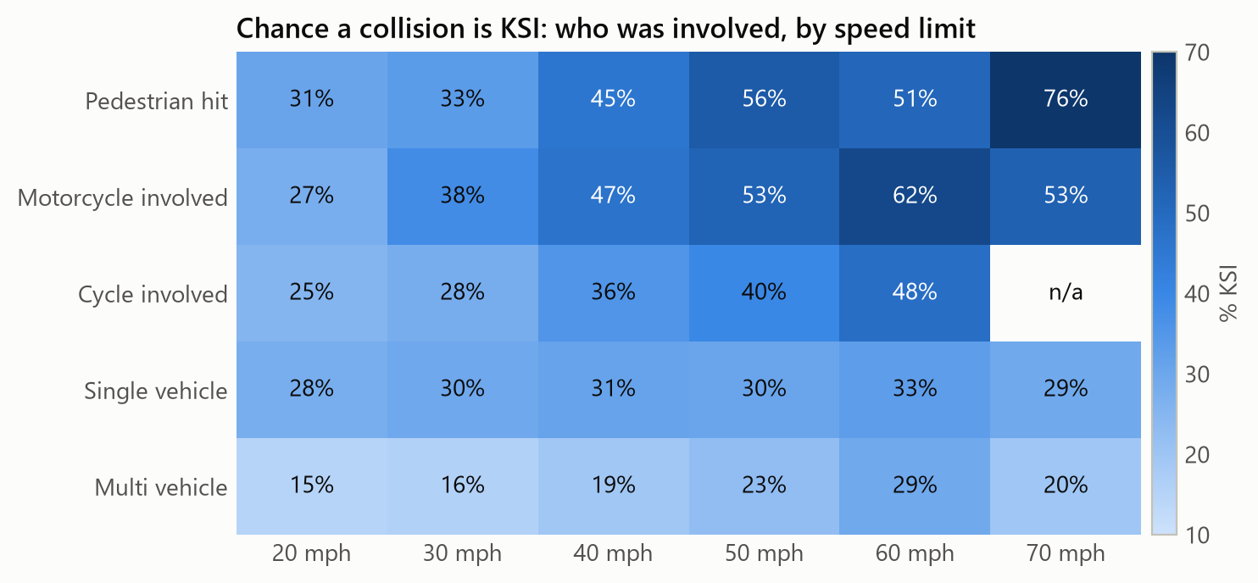
Speed hurts vulnerable road users far more than other crashes
43.6%
of motorcycle collisions are KSI, against 27.4% overall
37.1%
on 60 mph roads; motorways are 25.5%
36.9%
Cells with under 200 collisions show n/a. Injury-based records only.
Most KSI collisions: Fri 15:00. Highest chance of KSI: Mon 04:00 (45.6%).
in darkness with no lighting; daylight is 26.3%
Notes:
Speaker: Adarsh. This heatmap is the chance that a collision is KSI, by who was involved and the speed limit. Read along the pedestrian row: 33 percent at 30 mph, 46 at 40 and 51 at 60. The multi-vehicle row rises far less. Severity peaks on 60 mph roads, not motorways, and the most dangerous hours by rate are in the early morning, even though the most KSI collisions happen on weekday afternoons.

Slide 7
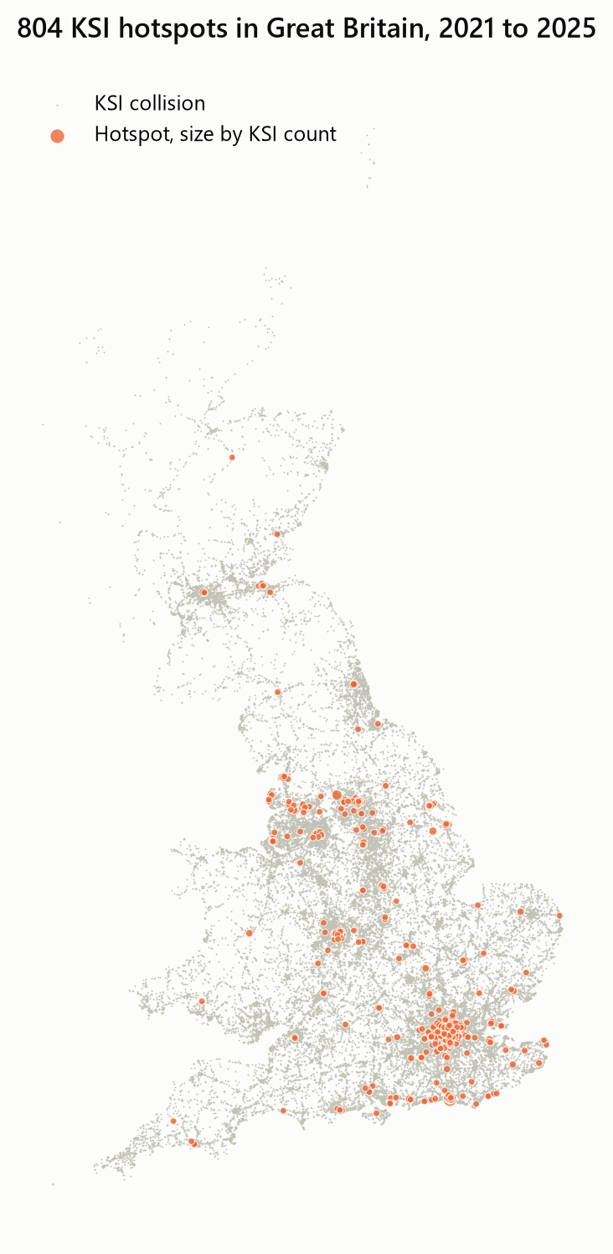
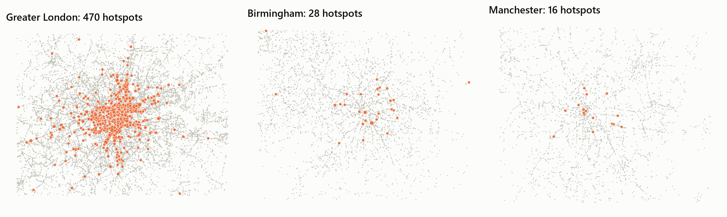
DBSCAN found 804 real hotspots, but most severe crashes are scattered
173 m
4.79×
93.89%
median hotspot span: a place an engineer can visit
2025 KSI per km², hotspots against random past sites
of KSI collisions fall outside any hotspot
Notes:
Speaker: Adarsh. We used DBSCAN because a black spot is a small dense patch and most severe crashes are isolated. K-Means would force every crash into a cluster. We tested 16 settings and required the largest cluster to stay under one kilometre, which gave eps 100 metres and min samples 6. Hotspots rediscovered on past years collected 4.79 times as many 2025 KSI collisions per square kilometre as random past locations. But 93.89 percent of KSI collisions are outside any hotspot, so hotspot work alone cannot solve the problem. Over to Vidushi.

Slide 8
107 of 109 rules held on a year the mining never saw
0.946
correlation of lift between the two periods
0.9%
median fall in lift on unseen data
Reading lift
2.0 means KSI is twice as likely as average. It shows association, not cause.
Notes:
Speaker: Vidushi. Apriori ran on 221,193 collisions from 2021 to 2024. Lift tells us how many times more likely KSI is under a condition than overall. We filtered 1,657 rules down to 109, then tested them on 2025. 107 kept a lift of at least 1.2. Blue is the mined period and orange is unseen 2025, and they barely differ. The strongest rule is a motorcycle leaving the road, where KSI is 66.7 percent likely in the mined period and 59.1 in 2025.

Slide 9
K-Modes segments confirm our reference paper's claim at scale
60
rules found only inside a segment
55
of those held on unseen 2025
Top hidden rule
Light: Dark, no lighting + Pedestrian hit: lift 1.78, 68.9% KSI inside S3.
Notes:
Speaker: Vidushi. Kumar and Toshniwal claimed that clustering first reveals rules the whole data set hides. They had 11,574 accidents from Dehradun. We repeated it with their k of 6 on 221,193 collisions from Britain. K-Modes suits categorical data because a mean of lighting types has no meaning. The segments range from 16.7 to 38.6 percent KSI. We found 60 rules that appear only inside segments, and we added a test the paper did not run: 55 of them held on 2025. So the claim survives on a much larger data set in a different country.

Slide 10
Severity is only partly predictable, and that is a real finding
Model | Accuracy | Precision | Recall | F1 | ROC-AUC | PR-AUC
Random Forest | 56.9% | 35.7% | 74.4% | 0.482 | 0.679 | 0.440
AdaBoost | 56.9% | 35.4% | 72.3% | 0.475 | 0.670 | 0.426
Decision Tree | 54.7% | 34.5% | 75.6% | 0.474 | 0.665 | 0.422
Naive Bayes | 54.4% | 33.8% | 71.7% | 0.460 | 0.638 | 0.376
73.0%
74.4%
Why not higher?
Impact speed, seat belt use and the health of the person hit are not recorded. Road context alone adds little.
accuracy from predicting Slight for everyone, catching no KSI collision
of KSI collisions caught by Random Forest at the threshold set on 2024
Notes:
Speaker: Vidushi. We trained four syllabus classifiers, tuned them on 2024 and tested once on 2025. Random Forest was best with PR-AUC 0.440, against 0.27 by chance. Accuracy looks low at 56.9% because the threshold favours recall. Predicting Slight for everything scores 73.0% and catches nobody. Severity depends on things the police form does not record, such as impact speed and seat belt use. A much higher score on data like this would make us check for leaked columns. We use this model to explain risk, not to predict single crashes. Over to Piyush.

Slide 11
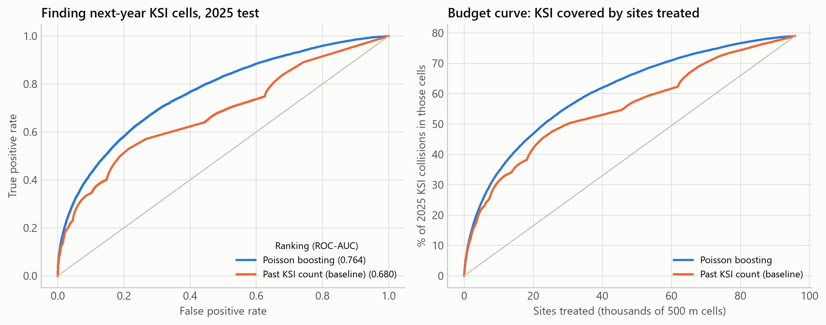
Ranking next year's sites beats a past-count list
Sites treated | Past counts | Poisson boosting
500 | 5.4% | 5.8%
1,000 | 8.6% | 9.3%
5,000 | 22.0% | 24.1%
10,000 | 31.2% | 34.3%
78.98%
+2.13 pts
-39.8%
of 2025 KSI collisions happened in a cell with past collisions. The rest cannot be ranked by history.
KSI covered at 5,000 sites (95% interval 1.78 to 2.53)
next-year fall in the 100 worst cells of 2024; the data records no treatment
Notes:
Speaker: Piyush. Budgets are spent on places, so we moved to 500 metre grid cells. Three past years of features predict the next year, and we tested on 2025. Poisson boosting reached ROC-AUC 0.764 against 0.680 for ranking by past KSI count. At 5,000 sites it covers 2.13 more percentage points of KSI, and the bootstrap interval excludes zero. The gain is small at the very top, so we do not oversell it. Then the trap: the 100 worst cells of 2024 fell 39.8 percent the next year, and the data records no treatment. That is what regression to the mean predicts, and it is why worst-site lists can look better than they are.

Slide 12
The output is a 2026 priority list an engineer can act on
# | Road | Authority | KSI 2023-25 | Suggested review
1 | A3 | City of London | 23 | Cycle separation and junction protection
2 | A201 | City of London | 28 | Cycle separation and junction protection
3 | A201 | Southwark | 19 | Cycle separation and junction protection
4 | A3 | Southwark | 19 | Cycle separation and junction protection
5 | A401 | Westminster | 35 | Pedestrian crossing and speed
6 | A40 | Westminster | 21 | Cycle separation and junction protection
7 | A40 | Westminster | 29 | Cycle separation and junction protection
How an authority uses it
98%
Choose a budget, take that many sites from the list, read each site's pattern on the interactive map, and send an engineer to verify it.
of the top 100 sites are near a DBSCAN hotspot
Notes:
Speaker: Piyush. This is the decision. We refit on the latest data and scored 2023 to 2025 to give a list for 2026. Each site gets a suggested review type from its own collision mix. 98 percent of the top 100 sites lie within 750 metres of a DBSCAN hotspot, so two independent methods agree on where the problem is. The review type is a prompt for an engineer, not a model prediction, and we claim no crash reduction. The interactive map and the full list of 1,000 sites are in our GitHub repository.

Slide 13
What we can claim, and what we cannot
Tested on unseen 2025
Limits
804 street-scale hotspots
107 of 109 rules held
Site ranking beats past counts by 2.13 points at 5,000 sites
The paper's clustering claim holds at scale
No traffic volumes, so busy places rank high
Association, not cause; no crash reduction claimed
Police-reported injury collisions only
Numbers describe Britain; the method transfers to India through eDAR
SDG 3.6 road deaths and injuries. SDG 11 sustainable cities and safe transport.
Reference paper: Kumar, S. and Toshniwal, D. (2015). A data mining framework to analyze road accident data. Journal of Big Data, 2, 26.
Data: Department for Transport, Road Safety Open Data, Open Government Licence v3.0.
Thank you. We are open for your questions.
Notes:
Speaker: Piyush. To close: we can stand behind these results because each was tested on a year the methods never saw. We are equally clear about the limits. There is no traffic volume data, so busy places rank high partly because they are busy, and we show association, not cause. Our code, notebook, report and interactive map are on GitHub. Thank you, and we are open for your questions.

